Slide 1

preschool at Newton on Trent
Pre-School Parent Workshop
2026

Slide 2
Welcome to newton
Key updates:
* What an exciting year! We have now introduced two-year-olds to our school and what a wonderful change it has been for all of us
* We have expanded our numbers significantly this year, growing to around 80 children!
* We are, therefore, having a lot of building work done this summer to ensure we have everything we need to continue to provide the very best opportunities for our children – watch this space!
* Our provision will remain largely the same overall but may look a little different when the children return in September, as we always have a refresh to ensure the provision suits each individual cohort.

Slide 3

Who are we?
As we are a Church school, our Christian values underpin all that we do.
The values are woven into the curriculum and are discussed throughout the day with children as we encourage them to show these values as they Aim High and Enjoy the Journey. We will be listening to Bible stories and thinking about what these words mean to us and to others and how we can bring these values into our classroom, the school and wider community.
We consider things that are expected and exemplary behaviours, and also those which allow us to strive and challenge ourselves, to be Aiming High and having fun and caring for ourselves and each other as we learn to be Enjoying the Journey.
Each Friday we hold an Aiming High Assembly at the church and invite adults to join us celebrate instances from the week where children have stood out for showing the values. Children can also show how they have enjoyed the journey as they share swimming badges, Rainbow or Beaver badges or any out of school achievements with the school community. If you child wishes to share something, please pass it to me on the Friday morning.

Slide 4
Who am i?
* I am Mrs Jones – I am the class teacher in Oak. I have taught in both EYFS and Key Stage 1 at Newton.
* I am also the school’s Community Lead and Art Lead
* I live in Saxilby with my husband and my son, 6, who also comes to Newton.
* I have a background as a PR and marketing manager for large companies, but have always dreamed of being a teacher, so I took the leap after maternity leave and have never looked back!
* I am incredibly passionate about my job and do all that I can to ensure that your children are given every chance to flourish during their time in my class. I am passionate about giving my class the very best opportunities to learn through play and real experiences, build resilience and independence, form a voice of their own and really just enjoy every second of the magic of early childhood. There is no better job than mine!
* I am supported in Oak by Mrs Wentworth and Mrs Rountree day to day, but a whole host of grown ups come in and help us through the week – everybody wants to be in Oak Class!

Slide 5
What do we do?
* There is a myth that EYFS is ‘just play’ – we do so much more than that! This is not a private nursery or playgroup setting
* We follow an extensive, broad and balanced curriculum which has been carefully constructed to cover each stage of the children’s development
* We learn through a combination of adult input, group work and child-initiated play; where children choose what activities they would like to do from the provision available
* Adults make constant choices about when to interject, join play or observe to ‘teach’ the focus skills and individuals’ next steps. This will vary from an adult modelling language as they take an active role in role playing a story or scenario, intervene to demonstrate how to share, or watch a child make progress with something and record it. If a child asks them to, an adult may demonstrate a skill, fetch further resources to enhance the children’s play, or otherwise enhance the play or provision at the child’s instigation. Adults may also scribe a child’s story, or model recording scores for games or making signs for role play
* Adults will also model communication skills, using rich language and vocabulary and encouraging children to share their ideas and partake in reciprocal conversation

Slide 6
A typical morning in Oak Class
For our youngest children, a typical morning may look like this:
8.20am: arrive at school, hang up own bag and coat, vote for a story, self-register and say goodbye to family. Put away own bottle and book. Sit on the carpet and play with peers.
8.35am: answer the register with a wave, “hi” or good morning – depending on the individual child.
8.50am: put away the resources and sit in a circle ready for the morning song. Sing the song and then take part in the class count and calendar chat.
9am: get ready to head off for group work with a grown up – usually maths-based learning and nursery rhymes– and flourishing time.
10am: join the rest of the class for snack at the table. Fetch (and peel!) own snack and milk and put own straw in with support if needed. Listen to the story that the class voted for.
10.15am: join a grown up for literacy time, reading the story of the week and discussing. More group work – this time, key skills linked to the story or weekly theme.
10.30am: flourishing time.
11.15am: tidy up with the rest of the class.

Slide 7
A typical lunch time in Oak Class
For our youngest children, a typical lunch may look like this:
11.40am: wash own hands, fetch own lunchbox (if applicable) and water bottle and line up for lunch. Say the lunchtime prayer.
11.45am: walk to church. Find a seat and either open own lunchbox (with support) and start to eat, or line up to fetch own dinner. Scrape own plate and tidy away main course before pudding.
12.15pm: tidy up the table, fetch own water bottle and lunchbox and line up.
12.20pm: put own lunchbox and bottle away, use the toilet if needed, fetch coats/hats and line up for play. Head onto the big playground to play with Birch Class.

Slide 8
A typical afternoon in Oak Class
For our youngest children, a typical afternoon may look like this:
12.45pm: come back into class, use the toilet and have a drink, then sit quietly on the carpet for register. Answer the register with a wave, “hi” or “good afternoon”.
12.55am: teacher input. Look at a book, short video, leaflet, object, etc. linked to the topic.
1.05pm: group work. Go with a grown up to practice key skills or further learning through an organised activity.
1.15pm: flourishing time.
2.10pm: tidy time.
2.20pm: collective worship. Sit on the carpet for a story and discussion linked to the worship theme of the week.
2.40pm: fetch own bag and belongings and get ready to go home. Put on own coat and bag and line up at the door.
2.50pm: home time!

Slide 9
Communication
* Parent/school engagement is incredibly important, and we do all that we can to be available to you if you ever have any concerns or questions.
* I am always happy to talk to you before and after school or arrange a meeting or phone call at a more convenient time
* Please use the home-school diary to record notes about your child, communicate with us and tell us what you have been reading or doing at home – we love to hear your updates!
* We use tapestry to keep a log of significant moments and progress and encourage you to do the same – please send us any key moments you may have at home!
* Should any accidents occur, they will be tended to, with a first aid slip coming home. Where we have head bumps a letter is sent home and we will give you a call as our duty of care (even if it is minor). The letter has an attached reply slip to be returned so we know you are aware of your child’s bump. Please place the reply in your child’s diary. We also have the school Calpol that can be administered if a child is feeling ill, we will call you to ask permission first.
* All medicines, including inhalers, must be taken to the office with a form filled. Please do not give medicine into the care of your child or teacher.

Slide 10
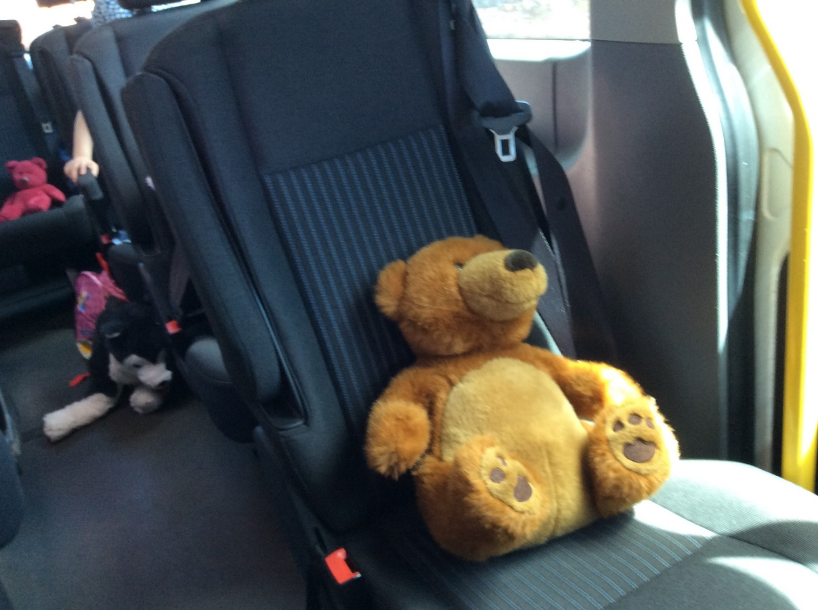
Ted’s adventures
* Children will take turns to have a visit from Ted for about a week.
* Please write in Ted’s journal to show what he and your child got up to, and as children develop, they will be able to write in the book themselves.
* Please do not feel any pressure, Ted loves to go shopping, play at the park or watch a film and relax!
* What Ted does enjoy is listening to the children telling us about what he got up to and building their confidence to talk to the group.

Slide 11
assessment
* We have two parents’ evenings a year, one around October and one after Christmas. We send home a report every summer.
* We assess the children several times through the year – they usually aren’t aware of this when it is happening!
* If we have concerns about your child’s progress during the year, we will speak to you, and they may be added to our watchlist for some extra support and further monitoring. If you have any concerns yourself, please do always let us know!
* By the end of Reception, children will be assessed against the Early Learning Goals (ELG), which is a statutory assessment.

Slide 12
What do you need to do?
* Year on year, we find that parent engagement is absolutely essential to our children’s progress.
* Although they are very little, the children are learning more now than they ever will, and you play a pivotal role in that learning.
* Working together in partnership with school will give your child the best chance to flourish and make progress – I know that you want that as much as we do!

Slide 13
Reading
Please read as much as possible with your child. At a minimum, you should aim for one to two stories per day, with a mix of repetition and new texts.
Try for a wide range of texts; picture books, non-fiction books, recipe books, poetry, nursery rhymes, traditional tales, classics, wordless books, old favourites, comics and more. The wider variety, the better. If in doubt, have a look at the canon for inspiration.
Our local libraries have a wonderful selection, and car boot sales are a gold mine!

Slide 14
Talk, talk, talk
Spend quality, screen-free time with your child and talk to them as much as possible.
Eat meals together at the table, chat in the car and on walks, make up stories, play rhyming games, sing songs, recite nursery rhymes and narrate your day as much as possible. Include them in day-to-day life!
Aim to model good conversational habits to your chid, expecting reciprocal talk and back and forth conversation, keeping the talk going and giving them your full attention.

Slide 15
Before starting ‘formal phonics’
Children will not be able to learn phonics if the correct building blocks have not been put in place. At Newton, children have been working on these in small group work, opportunities in the enhanced provision and all the continuous provision that there is in the classroom practise and within school. There are many aspects to what children need to be able to do prior to starting phonics on their journey to reading and writing, these include:
Sound discrimination
Linguistic concepts (shape/size/colour/texture etc)
Speak in sentences of at least 6 words
Learnt several nursery rhymes that they can recite
Know several stories and be able to simply retell them
Role play stories and acted them out with some simple key phrases
Rhyme – hearing and continuing rhymes
Distinguishing between different sounds
Orally blending sounds
Ability to listen and attend to what is being said
Hold back and forth conversations
Express their ideas and needs

Slide 16
Counting
Great maths skills are built on secure number sense – understanding the way in which numbers are made up, how they fit within our number system and their relationships with each other, just as a start.
Start with counting to 3. “1,2,3 wheee” is a great start!
You can also start comparing quantities by noticing amounts such as ‘more’, ‘less’, and ‘all gone’. This one is great to do at the dinner table. Number rhymes and counting songs are also very beneficial.
You can then have a go at subitising, noticing groups of numbers to 3 and talking about how they are made up, without counting. Ask your child, “What do you notice?” and talk about what you can see. This can be done in the park, the garden, at the dinner table, in the bath.
As your child starts to grasp these skills, you can move to numbers up to 5.

Slide 17
Shared experiences
In schools, we use the phrase “cultural capital” to (put very simply) describe a child’s life experiences, their subsequent ability to apply context and understanding to what they are learning at school, and how they then understand and experience the world.
Building childhood experiences doesn’t need to be expensive and isn’t about what you do or don’t have. Just enjoy the simple magic of everyday experiences together. Think back to your own core childhood memories, what makes them stand out?
Has your child:
* helped do the washing up? * helped with the laundry? * met a pet dog or cat?
* been to the woods? * been to the beach? * been to a park?
* played in a paddling pool? * played throwing and catching? * looked for bugs in the garden?
* baked in the kitchen? * played a board or card game? * done a jigsaw ?
* experienced something cold? * helped to wash the pots? * weeded a flower bed?

Slide 18
Motor skills
Before you can write, you need to have developed certain skills. This includes gross motor skills which gives the strength and dexterity to carry out large movements such as walking, climbing, running. It also includes fine motor skills, which are smaller more accurate movements made with the hands and fingers like pinching, drawing, flicking, threading.
Gross motor skills can be improved by running, jumping, climbing, mixing, digging, riding, dancing.
Fine motor skills can be improved by colouring, drawing, threading, stickers, picking up small items, using pegs.

Slide 19
Independence
Put simply, don’t do everything for your child. This is very tempting, especially when you’re in a rush. We are seeing increasing numbers of children who can’t get dressed, put on or take off their shoes and socks, carry their own bag, walk to and from school, put on their coat or a hat, open a lunch box, use cutlery…
This summer, try to really encourage your child to have a go at things by themselves. Tell older siblings and grandparents, too! Plan extra time into getting ready if you need to, and give them the opportunity to show you what they can do – you will be surprised! Don’t be tempted to help them out too much, speak for them or take over if they fail, give them space to keep going and keep trying.
Children’s confidence and resilience sky rockets when they are given the chance to be grown up and do things themselves, or speak for themselves, and it makes all the difference when they arrive in September. Every little helps.

Slide 20
Boundaries and expectations
At Newton, we live and breathe our school vision and values, and this is what makes our school such a special place to be. Some parents have asked how they can replicate this at home.
Boundaries and expectations do not have to be at odds with being kind, gentle and nurturing. We have very high expectations of our children to aim high at every opportunity, show great manners, be independent, be kind, be courteous and make the most of every opportunity to learn.
Our approach is simply to expect certain behaviour, and model it ourselves. We greet the children politely and expect a reply, we use manners and kindness and expect them to be reciprocated, we give an instruction and expect it to be followed. This can all be done with kindness, but by holding boundaries, using logical consequences, following through and not letting the little things go. What you ignore, you encourage. Our children are secure and confident in knowing what is expected of them.

Slide 21
Wraparound care
We have a fabulous breakfast club and after school provision, Cheerios. The great thing about Cheerios is that it is run by our own Mrs Wentworth, who the children already know and have a relationship with. Children can stay until 6pm and are offered a choice of snack or a hot or cold meal.
Our breakfast club is free to all children and runs from 7.30am until school starts.

Slide 22
lunches
Our catering provider, Good Lookin’ Cookin’, sends tasty and nutritious meals each day, with a choice that suits everybody. You can order these meals through the app and they are very reasonably priced. If you haven’t ordered one, you must send a packed lunch.
If you are sending a packed lunch, please ensure that it is balanced and healthy and is an appropriate amount of food for your child.
We have seen a marked increase in lunchboxes filled with sugar and ultra-processed food this year, with some children not having anything fresh provided for lunch at all. A healthy lunchbox doesn’t need to cost a lot, and children are often more adventurous with their eating when they are at school, compared to at home.
As a general guide, a sandwich with some protein or a pot of pasta is ideal, with some veg sticks, fruit and perhaps a yoghurt or occasional small treat like a cake, malt loaf or biscuit. Treats should not be confectionary; as a rule of thumb, you should look in the biscuit aisle rather than the sweet aisle and we would advise, ideally, no more than once or twice a week.
Please never send nuts or nut-based spreads, as we have children with significant allergies in school. Please also ensure small and ‘frictiony’ fruits such as blueberries, grapes and cherry tomatoes are halved or quartered lengthways.

Slide 23
Having everything they need
Please remember to:
* send wellies in September and when they go up a size
* pack a water bottle
* send plenty of spare clothes and underwear
* send plenty of nappies, bags and wipes
* not send toys, sweet treats or dummies
* send weather-appropriate clothing – we are outside a lot!
* drop off and pick up promptly
* come to school as much as possible

