Slide 1

Phonics at Newton on Trent
Pre-School Parent Workshop
2026

Slide 2
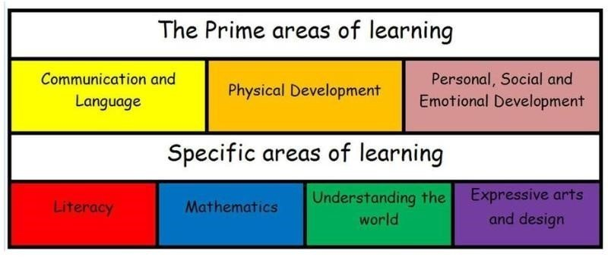
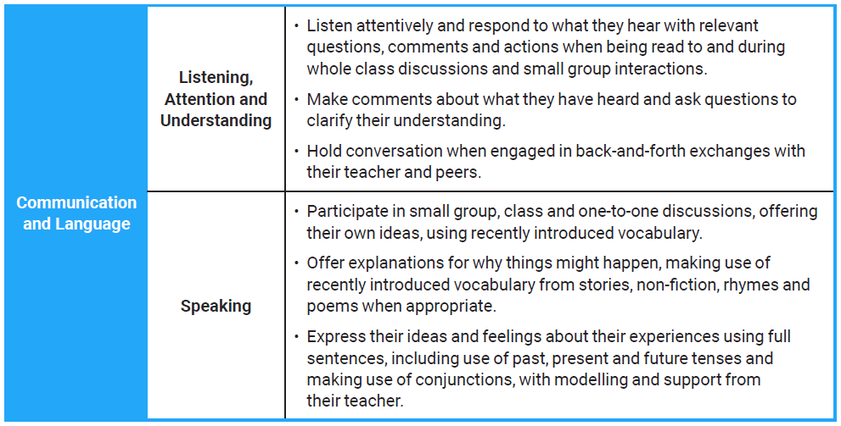
What comes before Phonics?
Language and Communication
Communication and language underpins all areas of learning and as such is one of the Prime areas of Learning in EYFS. Without it, children will not be able to make progress in the specific areas – one if which is literacy – word reading, writing and comprehension.

Slide 3
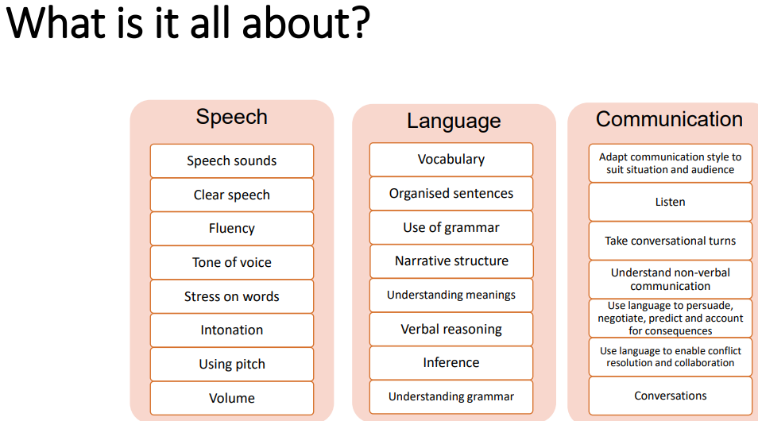

Slide 4
Before starting ‘formal phonics’
Children will not be able to learn phonics if the correct building blocks have not been put in place. At Newton, children have been working on these in small group work, opportunities in the enhanced provision and all the continuous provision that there is in the classroom practise and within school. There are many aspects to what children need to be able to do prior to starting phonics on their journey to reading and writing, these include:
Sound discrimination
Linguistic concepts (shape/size/colour/texture etc)
Speak in sentences of at least 6 words
Learnt several nursery rhymes that they can recite
Know several stories and be able to simply retell them
Role play stories and acted them out with some simple key phrases
Rhyme – hearing and continuing rhymes
Distinguishing between different sounds
Orally blending sounds
Ability to listen and attend to what is being said
Hold back and forth conversations
Express their ideas and needs

Slide 5
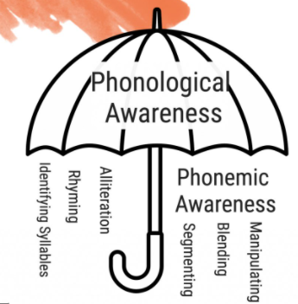
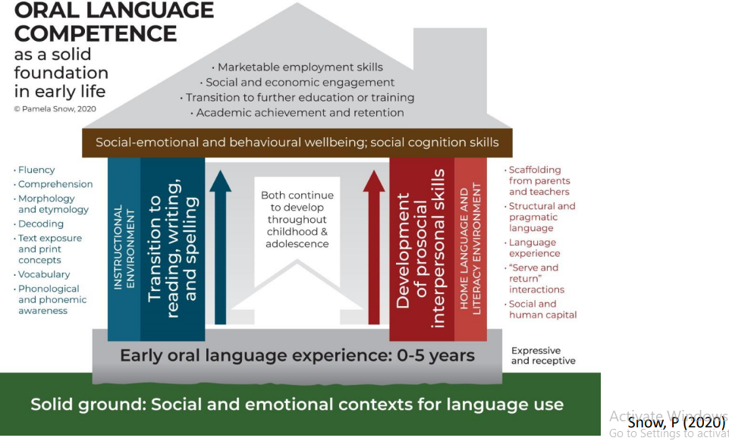
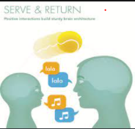

Slide 6


Slide 7
SO what is Read Write Inc.?
Since Jim Rose conducted a review of early reading in 2005, and reported that phonics is the most consistently successful approach to teach reading, phonics has been used as the main way to teach children to read in English schools.
Since 2022 and the publishing of ‘The Reading Framework: Teaching the Foundations of Literacy’, all schools must now use a synthetic systematic phonics scheme to teach phonics, this is where children learn the letter sounds as building blocks to reading and writing words.
Read Write Inc. is one such scheme to teach phonics. It was developed by Ruth Miskin, and has lots of research behind it. We have been using it at Newton since 2016 with great success.
Much of it’s success comes from the consistent approach the programme uses and the way in which it makes such strong links between what children are reading and what they are writing. It also enables children to really build confidence as they only use sounds they are confident with. It also ensures strong consistency across the school.
RWI sessions are positive, inclusive and foster lots of confidence in children.
It gives the children all the skills required for Reception and Year 1, and even exceeds the national curriculum requirements in some areas.
https://www.youtube.com/watch?v=i5O4yvZSOsc – Ruth Miskin’s explanation.

Slide 8
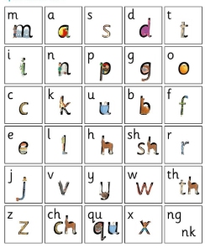
Sounds are taught in sets. There are 3 sets, 1,2 and 3. They get progressively more complex.
The sounds taught are ‘pure sounds’ that means saying mmm, not ‘muh’ or ‘em’
This video demonstrates the sounds children will be learning
https://www.youtube.com/watch?v=qB6SvZscxgg

Slide 9
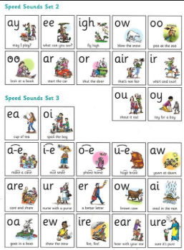
Set 2 and 3 sounds

Slide 10
Nursery session
In preschool, they are learning the set 1 sounds. Sessions are kept very simple and short.
They work in their group to:
First learn the picture names and then learn the sound associated with each picture - we did this last term
Now they are learning the sound associated with each letter – reading the sound
Air write the letter. Then learn to write the letter.
Orally blend sounds together with ‘Fred Talk’; this will be simple words like it, on, mat etc to start with, using the sounds they are most confident with.
Reading the sounds and blending them themselves with Fred Talking and reading on green word cards.
Children may then move onto reading the books.

Slide 11


Learning the sounds
The letters are either stretchy or bouncy.
Stretchy – m, s, n, f, l, r, v, z,
Bouncy – a, d, t, i, p, g, o, c, k, u, b, e, h, j, y, w, x

Slide 12

Special Friends
Are what RWI calls digraphs and trigraphs, two or three letters making one sound. The first special friends the children will encounter are digraphs in Set 1, which are sh, th, ch, qu, ng and nk.
Later in Set 2 and 3 they are all either digraphs or trigraphs such as as ‘ay’ and ‘air’. At this stage any attempts to write a word that are phonetically plausible are praised – such as ‘cayc’ or ‘howm’.
In Set 3 children learn alternative ways to write the same sound and the focus shifts to using the correct sound and therefore spelling for a word, especially for things like to, too and two or stare and stair, when they are actually different words with a different spelling and meaning, despite sounding the same (homophones).
Split vowel digraphs (where the digraph is separated by a consonant) come in Set 3 and are described as ‘holding hands behind someone’s back’, this is in words such as cake, bike, home, brute etc. The special friends are shown with a rainbow, and children will say, where’s my friend? He’s on the end. Gone are the days of ‘magic E’!

Slide 13
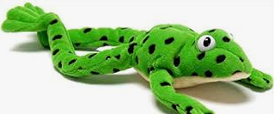
Fred talk
Meet Fred!
Fred can only talk in sounds, such as m-a-n and helps children learn to blend and segment words so they can read and write them. If you ask a child to ‘Fred talk and read’ that would mean identifying and saying the sounds in a word, blending them together and then saying what the word is: m-a-t, mat. Children may need to Fred talk the sounds repeatedly before they can hear the word when they first start and sometimes need someone else to say it for them to hear. Encourage them to do it faster if they are struggling so they can hear them blending together.
Fred talk is first done orally, so children do not see any letters, but just listen to the sounds said by the adult. They have to be able to remember the sounds and blend them together to say the word. Incorporating this into your daily routines is good way to help children to blend using visual cues, such as asking them to get their c-oa-t or have a w-o-sh (remember to use the sounds you can hear and not think about spelling at this stage and to use pure sounds so mmmm-u-g, not muh-u-g) If they are struggling you might try ‘onset and rhyme’ so say m-an or d-ish, c-oat.

Slide 14



Red words and green words
RWI calls ‘tricky words’ red words. These are words that cannot be sounded out with Fred talk(these may change through your child’s English journey as sounds they have not been taught yet get taught later in the program, such as ‘e’ making the ‘ee’ sound. So he is a red word until children have learnt ‘e’ as ee). Said is always a red word. Other examples in children’s early learning are ‘the’ and ‘of’,
Green words are those that can be sounded out using phonics. Children will only be expected to read green words with sounds they have been taught. As children are learning to read words with a new sound, word cards have dots and dashes to show if they are a single letter grapheme or a digraph. RWI calls digraphs special friends, 2 letters making 1 sound.
As children become more confident, the dots and dashes are taken away.

Slide 15
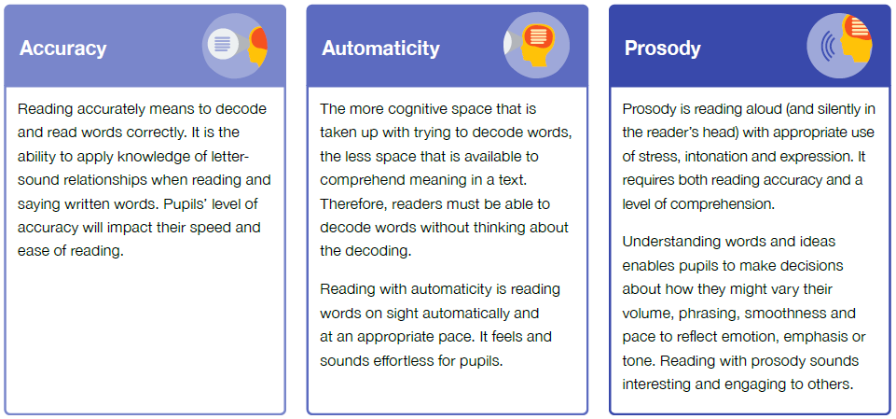
Fred in your Head
As children become more familiar with recognising sounds and Fred talking them out loud, they are encouraged to internalise this process in ‘Fred in your Head’. This is where children say the sounds in their head and then only say the complete word aloud. The transition to this stage requires some encouragement and whispering or mouthing the sounds silently can really help your child take this step to becoming a more fluent reader.
Reading fluency can be defined as reading with accuracy, automaticity and prosody. When pupils read
fluently, their cognitive resources can be redirected from focusing on decoding and onto comprehending
a text. For this reason, fluency is sometimes described as a bridge from word recognition to comprehension.
Learning to read, then reading to learn.

Slide 16

Fred Fingers
Children are taught to segment words for spelling by putting a sound on each finger. At the early stages, we tell children how many fingers and therefore sounds they need, and later children count the sounds and fingers themselves.
They hold the fingers up on their non-dominant hand, with their palm facing them, leaving their other hand free to write.
Children say the word, then pinch the sounds of their non-dominant hand with their writing hand, left to right, and then write down the word.

Slide 17
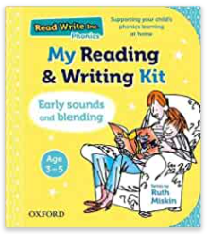
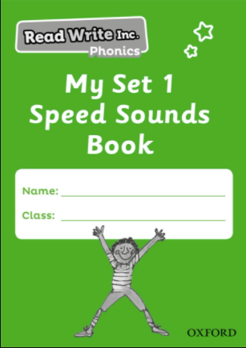
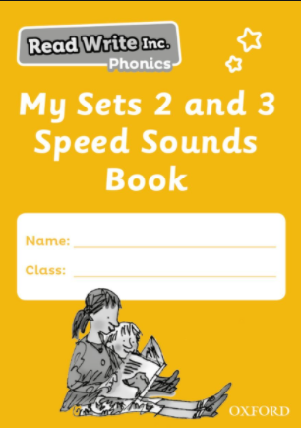
At home
Parents can support their child by reading both their RWI Books every day and their library books and any other books you like! Please record daily reads in your child’s Home School Book. This is really important evidence for us on what they struggle with/do well with and how they are enjoying learning to read at home. It is a great way for us to work together to improve your child’s reading.
Each child will be provided with a Reading and Writing Kit, then later in Reception a Speed Sounds Book. This will show you which sound they have learnt on the day and give you the chance to consolidate the learning with your child.
The more a child practises, the better they get, the more confident they feel, the more they enjoy it, the more the want to do it, the better they get and so on (remember the house).
It is also very valuable to show your child that you are interested in their education and that it matters to you.

Slide 18
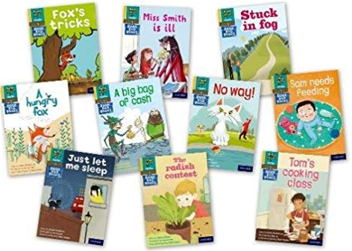
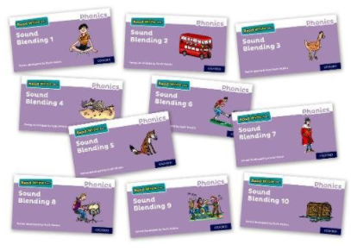
Books to go Home
We are delighted to have purchased ‘Book Bag’ books for children to bring home to read with you. These are books which rely on phonics alone to decode the words.
As children learn sounds and how to blend and segment them, they will read books closely matched to their developing skills in school. RWI has cleverly designed this range of books to link to the book children are currently reading in school.
They will bring home a reading book (that they will just have read in school) and the corresponding Book Bag Book to match.
It is imperative that you practise reading these books with your child. Remember the house – children with better communication and language skill are better prepared for literacy, and better prepared for life. Lots of research has made undeniable links to a child’s standard of literacy from 0-5 to their overall life chances.
In line with the new Reading Framework, children using RWI will not be bringing home Oxford reading Tree books(or any other books not phonetically decodable and using sounds or tricky words the children may not have learned yet). These types of books will come home after children have finished RWI, usually as they start Year 2, but depends when they are ready.
They will still have their weekly library book to read with grown ups for pleasure and exposure to different kinds of texts. Children also use lots of texts to base their learning on in the classroom too.

Slide 19
SO, What do we do with our phonics now then?
There are lots of opportunities for children to use and apply their burgeoning phonics in the classroom from writing slips to identify their work, to creating shopping lists, writing letters, devising recipes and sending cards. Children also have a range of books they can enjoy in the classroom and adults provide displays and activities to practise reading when playing.
Children will have half termly assessments to monitor their progress and group them appropriately.
There are 9 levels of book; Sound Blending Books, Red Ditties, Green, Purple, Pink, Orange, Yellow, Blue and Grey, building in skills, devices and special friends used. Some books are non-fiction too to ensure a breadth of experiences. Children read the books several times to build accuracy, fluency and a story teller voice. These are either done over 3 or 5 days depending on the level.
There are 8 levels of ‘Get Writing’ books linked to the story books, which children complete as they work through their reading books. These build their spelling, grammar and punctuation skills and are heavily linked to the reading book.

Slide 20

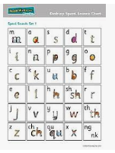
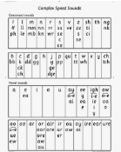
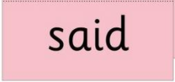
Embedded in school life
Obviously, reading and writing skills are used in many ways across the curriculum. Children will be encouraged to use all their new learning and strategies across the curriculum, such as going round the dinosaur’s bottom when writing about dogs in science to remembering which is the correct grapheme for the ‘ay’ sound in shape when writing their maths reasoning about shapes.
As such, all of teaching adults in school have had training and new resources have been purchased for each classroom, such as desk mats and speed sound charts.
In EYFS, children are encouraged to write in their play, such as signs for shops, letters, creating tickets for the train or anything else that crops up! They are encouraged to use the resources around them to become independent.
RWI will be used through the school, with the same resources, support and vocabulary used around phonics to provide consistency and a common language.

Slide 21
Logistics
After children are assessed, they are grouped. Children work at the level where they are confident. Small groups happen around the school in designated teaching spaces, such as classrooms, the Haven, the Library and the old Staff Room.
As the sound sessions, story books and Get Writing activities cover all the requirements for many EYFS and KS1 English/Literacy objectives, such as spelling rules, full stops, capital letters, question marks, exclamation marks and starting to use commas and speech, these sessions will be the children on the program’s English sessions. This is usually the case until the end of Year 1, with children starting the National Curriculum in Year 2. However, if a child needs to remain on RWI to ensure they are working at the correct level for them, they will continue with RWI to meet their needs. They will continue to learn further phonics and spelling rules as well as wealth of other things on the National Curriculum.
RWI will be taught at the same time as the English national curriculum sessions in other classes so that any children who are further up the school, but still need to develop their skills in RWI, will be working on their next steps for English, and not missing out on other curriculum areas.
The program is designed to be delivered by TAs and teachers and all staff teaching the sessions have had training.

Slide 22
Keep up not catch up
The RWI program expects children to keep up, not catch up.
This means that children will be having ‘Pinny Time’ throughout the day where any sounds, or groups of words a child is struggling with are shown to them repeatedly and practise with blending takes place. It can take as many as 30 exposures to a new sound or word for a child to have it embedded. For others, it may take more. These are short rapid events that happen quickly and do not require children to leave their play. The adult will got to the child. There are other things that we can do too, depending on what the need is.

Slide 23
Story Time
Children have daily ring-fenced story time each day, and may even enjoy other stories, poems and rhymes too. This continues into Year 6.
As mentioned, children can access and swap their library book each week too to ensure they develop a love of reading.

Slide 24
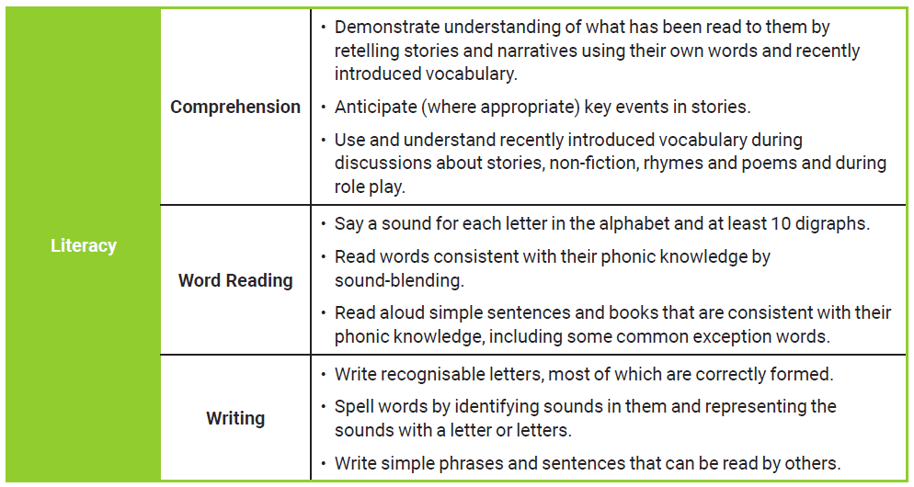
Statutory Assessment –
ELG for Literacy (new since 2021) At the end of Reception
The new ELG for Assessment in 2022 are:
There is no longer an exceeding descriptor. Children either meet the goal or don’t. If they do not meet it, interventions will be put in place with additional adult support.

Slide 25
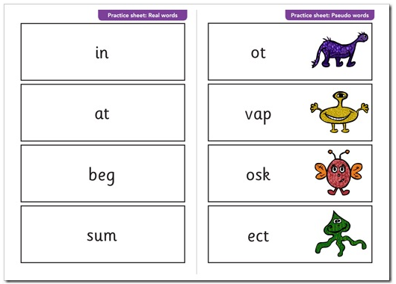
Year 1 phonics Screen
In June, children in Year 1 will undertake the statutory phonics screen check.
This is a test from the government and reported national to monitor the levels of reading and impact of phonics teaching across the country.
Children are asked to read 40 words, some are real words and some are ‘alien or monster words’. The children are expected to use only their phonic skills to decode the words.
For the last few years the pass mark has been set at 32.
Should a child not achieve the benchmark score and pass, further support will of course be put in place through Year 2 and the test retaken in June Year 2.

Slide 26
Q&A

Slide 27
Ready for reception?
When children have been with us since preschool, particularly when they do full-time hours, we find the transition to Reception to be much smoother than when children are new to the school. That said, some wobbles in September are still expected – and entirely normal!
There are some key things you can do, both before and during their Reception year, to help your child get the absolute most out of this incredibly important year in their education.

Slide 28
Getting ready…
* Lots and lots of reading and talking
* Lots and lots of counting (sensing a theme??)
* Shared experiences – no need to spend a fortune!
* Motor skills
* Independence
* Boundaries and expectations
* Having everything they need
* Coming to school!

Slide 29
Reading and talking
This is the big one – please read and chat as much as humanly possible with your child. For reading, at a minimum, you should aim for one to two stories per day, with a mix of repetition and new texts.
Try for a wide range of texts; picture books, non-fiction books, recipe books, poetry, nursery rhymes, traditional tales, classics, wordless books, old favourites, comics and more. The wider variety, the better. If in doubt, have a look at the canon for inspiration.
Our local libraries have a wonderful selection, and car boot sales are a gold mine!
Spend time with your child and talk as much as possible. Eat meals together at the table, chat in the car, make up stories, play games, sing songs and narrate your day as much as possible.

Slide 30
Counting
“But he can count to 20!”
This is amazing, and a real achievement for small children, but doesn’t mean they have developed the maths skills they need to carry them through the rest of their learning.
Great maths skills are built on secure number sense – understanding the way in which numbers are made up, how they fit within our number system and their relationships with each other, just as a start.
We can begin this by subitising, noticing groups of numbers to 5 and talking about how they are made up, without counting.
Ask your child, “What do you notice?”

Slide 31

What do you notice?

Slide 32
Shared experiences
In schools, we use the phrase “cultural capital” to (put very simply) describe a child’s life experiences, their subsequent ability to apply context and understanding to what they are learning at school, and how they then understand and experience the world.
Building childhood experiences doesn’t need to be expensive, and isn’t about what you do or don’t have. Just enjoy the simple magic of everyday experiences together. Think back to your own core childhood memories, what makes them stand out?
Has your child:
* been to a beach? * seen a sunset? * fed the ducks?
* ridden a bus or train? * watched the shapes in the clouds? * eaten in a café?
* cooked and prepared a meal? * been to a library or museum? * rolled down a hill?
* picked their own fruit or vegetables? * slept in a tent? * paid with coins?
* washed the pots? * climbed a tree? * had a picnic?

Slide 33
Motor skills
Before you can write, you need to have developed certain skills. This includes gross motor skills which gives the strength and dexterity to carry out large movements such as walking, climbing, running. It also includes fine motor skills, which are smaller more accurate movements made with the hands and fingers like pinching, drawing, flicking, threading.
Gross motor skills can be improved by running, jumping, climbing, mixing, digging, riding, dancing.
Fine motor skills can be improved by colouring, drawing, threading, stickers, picking up small items, using pegs.
Aim for a ‘pincer’ pencil grip – lots of pinching!

Slide 34
Independence
Put simply, don’t do everything for your child. This is very tempting, especially when you’re in a rush. We are seeing increasing numbers of children who can’t get dressed, put on or take off their shoes and socks, carry their own bag, walk to and from school, put on their coat or a hat, open a lunch box, use cutlery…
This summer, try to really encourage your child to have a go at things by themselves. Plan extra time into getting ready if you need to, and give them the opportunity to show you what they can do – you will be surprised!
Children’s confidence sky rockets when they are given the chance to be grown up and do things themselves, and it makes all the difference when they arrive in September. Every little helps.

Slide 35
Boundaries and expectations
At Newton, we live and breathe our school vision and values, and this is what makes our school such a special place to be. Some parents have asked how they can replicate this at home.
Boundaries and expectations do not have to be at odds with being kind, gentle and nurturing. We have very high expectations of our children to aim high at every opportunity, show great manners, be independent, be kind, be courteous and make the most of every opportunity to learn.
Our approach is simply to expect certain behaviour, and model it ourselves. We greet the children politely and expect a reply, we use manners and kindness and expect them to be reciprocated, we give an instruction and expect it to be followed. This can all be done with kindness, but by holding boundaries, using logical consequences, following through and not letting the little things go. What you ignore, you encourage. Our children are secure and confident in knowing what is expected of them.

Slide 36
Having everything they need
In Reception, children will need to wear their PE kit to school on a Friday. They also need to bring their reading diary and reading books every day.
Please also continue to remember to:
* pack a water bottle
* send spare clothes and underwear
* send weather-appropriate clothing
* order or pack a lunch
* drop off and pick up promptly
* engage with us and keep in touch ☺
* read, read, read
* come to school every day

