Slide 1

Reading canon introduction and Reading workshop KS1

Slide 2
Why is Reading our Focus?
Low reading skills in adulthood currently costs the country approximately 20 billion pounds a year.
Key contributor to poverty and intergenerational cycle of poverty.
Earn 60% than those with basic literacy.
Less likely to access health, housing and social care support which lead to poorer health outcomes.
Higher chance of divorce, health issues, incarceration, homelessness and unemployment.

Slide 3
Why is Reading our Focus?
There should a distinctive shift from the age of around eight to learning to read to reading to learn.
To access the secondary curriculum and finish school, you have to reach at least a reading age of 13. If you do not, you are more likely to not complete Secondary Education. 80% of children who ‘drop out’ of education are poor readers.
Poor readers are 60% more likely to underachieve in all subjects including maths.
The best readers read the most and those that read the most make more progress than their peers in almost all cases.
Those children that read every day at home make 6 months more progress than those that don’t.

Slide 4
Phonics
Since Jim Rose conducted a review of early reading in 2005, and reported that phonics is the most consistently successful approach to teach reading, phonics has been used as the main way to teach children to read in English schools.
Synthetic phonics is where children learn the letter sounds as building blocks to reading and writing words.
At Newton we use Read Write Inc. as the scheme to teach synthetic phonics.
Much of its success comes from the consistent approach the programme uses and the way in which it makes such strong links between what children are reading and what they are writing.
RWI sessions are positive, inclusive and foster lots of confidence in children.
It gives the children all the skills required for Reception and Year 1, and even exceeds the national curriculum requirements in some areas.

Slide 5
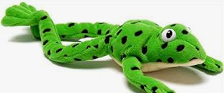
Fred talk and read
Meet Fred!
Fred can only talk in sounds, such as m-a-n and helps children learn to blend and segment words so they can read and write them. If you ask a child to ‘Fred talk and read’ that would mean saying the sounds in a word, blending them together and then saying what the word is: m-a-t, mat. Children may need to Fred talk the sounds repeatedly before they can hear the word. Encourage them to do it faster if they are struggling.

Slide 6



Red words and green words
RWI calls ‘tricky words’ red words. These are words that cannot be sounded out with Fred talk(these may change through your child’s English journey as sounds they have not been taught yet get taught later in the program, such as ‘e’ making the ‘ee’ sound. So he is a red word until children have learnt ‘e’). Said is always a red word. Other examples in children’s early learning are ‘the’ and ‘of’,
Green words are those that can be sounded out using phonics. Children will only be expected to read green words with sounds they have been taught. As children are learning to read words with a new sound, word cards have dots and dashes to show if they are a single letter grapheme or a digraph. RWI calls digraphs special friends, 2 letters making 1 sound.
As children become more confident, the dots and dashes are taken away.

Slide 7
Fred in your Head
As children become more familiar with recognising sounds and Fred talking them out loud, they are encouraged to internalise this process in ‘Fred in your Head’. This is where children say the sounds in their head and then only say the complete word aloud. The transition to this stage requires some encouragement and whispering or mouthing the sounds silently can really help your child take this step to becoming a more fluent reader.

Slide 8
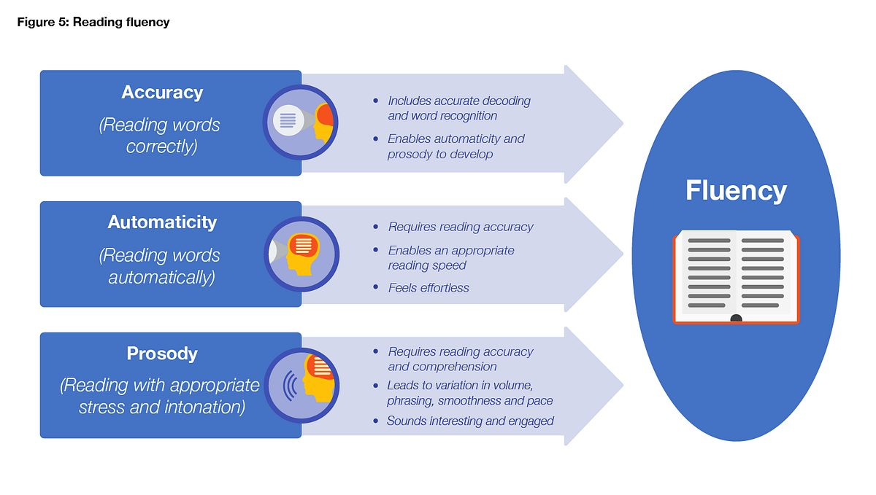

Slide 9
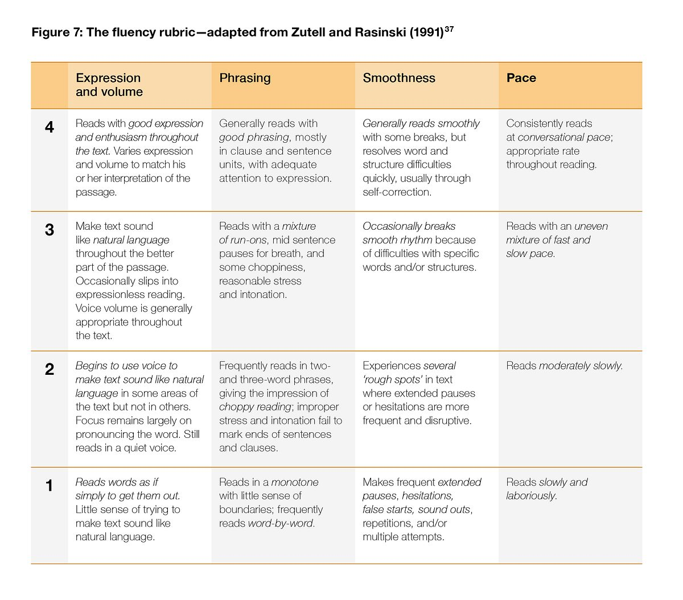

Slide 10
So what should we be reading, apart from daily reads of phonics books
This is where our Newton Canons come in!!

Slide 11
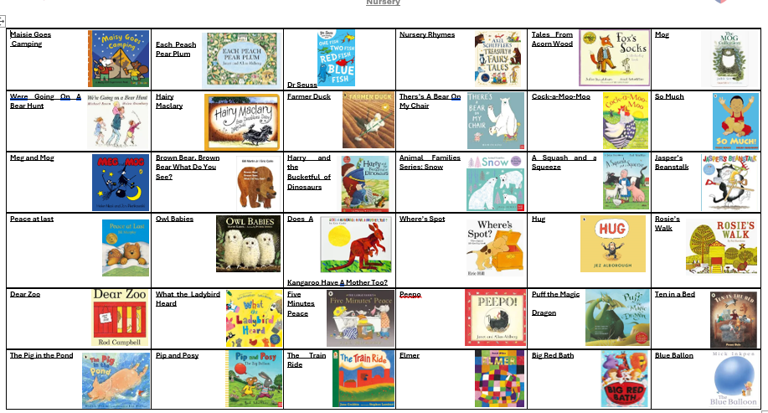
Nursery

Slide 12
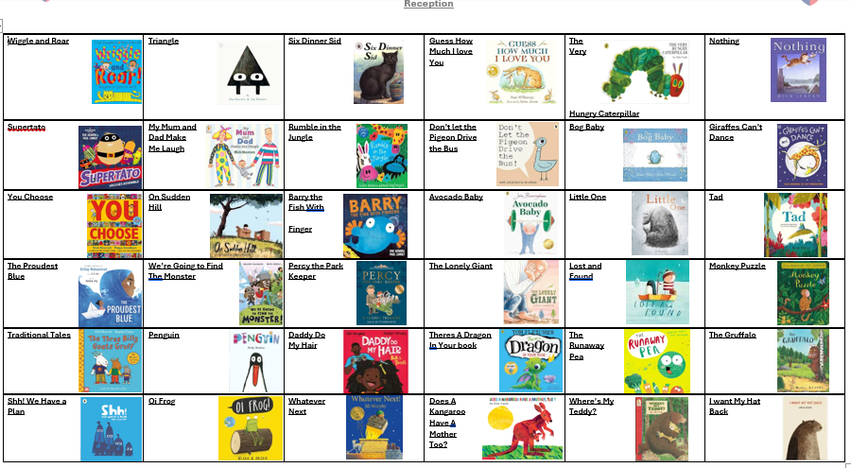
Reception

Slide 13
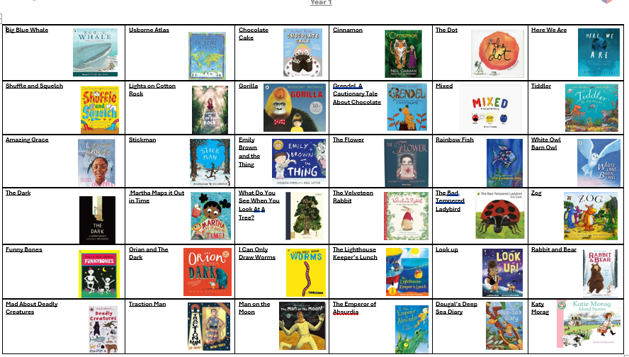
Year 1

Slide 14
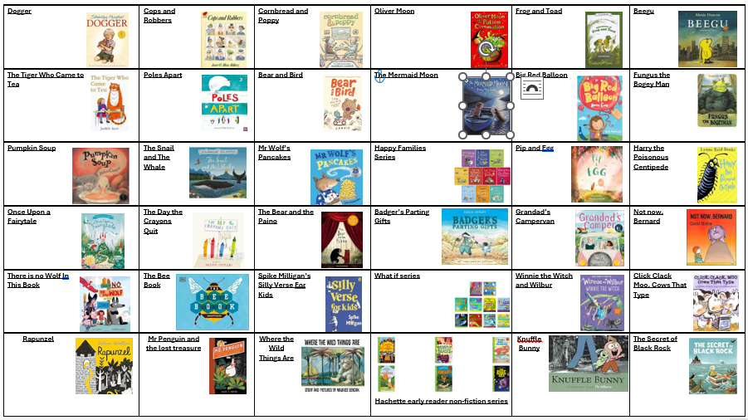
Year 2

Slide 15
We have primarily created a Newton Canon to ensure that children are getting a rich and broad diet to build vocabulary and allow then to access knowledge and worlds beyond their current world.
In our minds, reading is already reward enough, however, to incentivise the children further we are going to award points for completion. It is not a race, and points will only be given out at the end of the year. Teachers will be guiding and supporting children on appropriate books choices and it maybe they do not feel a book is appropriate for a child to read until further in the school year.

Slide 16
at home
Reading canon reading book
School phonics books/book band book to aid decoding, automaticity and fluency
Bedtime stories (canon or different)
Read again and again and again!

Slide 17
at home
Readers are made by hearing an expert storyteller. Reading the same book again and again means they can hear and learn story telling patterns.
Getting you child to join with parts they know with a story telling voice.
Practising story telling voices
Letting go of any second-hand embarrassment-children don’t care about you in that way and will just enjoy the story.
As they become more proficient you can work on echo and choral reading.
Provide your children with books!
1.7 million children do not own one book.

Slide 18
Questions?

Slide 19
Reading canon introduction and Reading workshop KS2

Slide 20
Why is Reading our Focus?
Flourishing for Life!
Low reading skills in adulthood currently costs the current approximately 20 billion pounds a year.
Key contributor to poverty and intergenerational cycle of poverty.
Earn 60% than those with basic literacy.
Less likely to access health, housing and social care support which lead to poorer health outcomes.
Higher chance of divorce, health issues, incarceration, homelessness and unemployment.

Slide 21
Why is Reading our Focus?
There should a distinctive shift from the age of around eight to learning to read to reading to learn.
To access the secondary curriculum and finish school, you have to reach at least a reading age of 13. If you do not, you are more likely to not complete Secondary Education. 80% of children who ‘drop out’ of education are poor readers.
Poor readers are 60% more likely to underachieve in all subjects including maths.
The best readers read the most and those that read the most make more progress than their peers in almost all cases.
Those children that read every day at home make 6 months more progress than those that don’t.

Slide 22
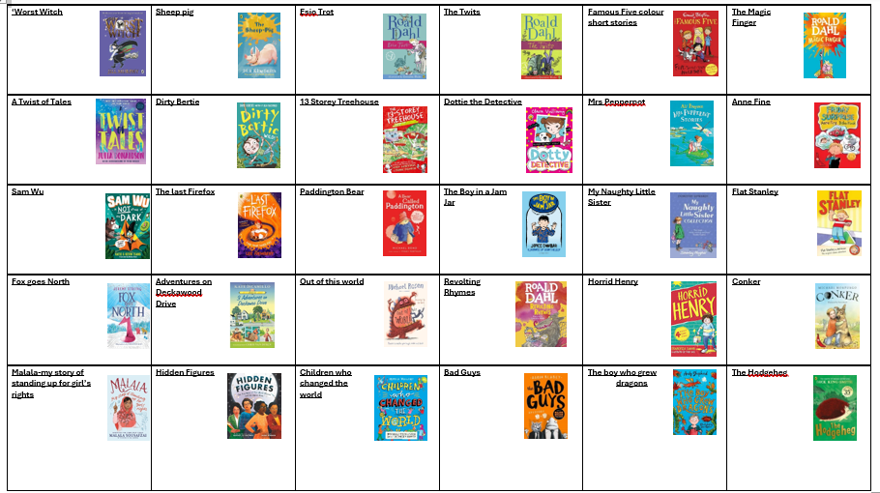
Year 3

Slide 23
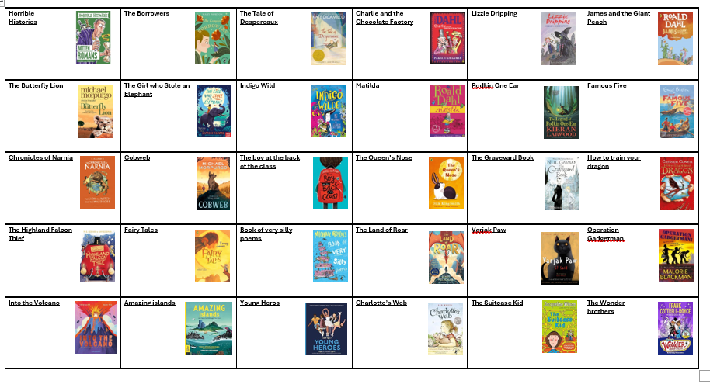
Year 4

Slide 24
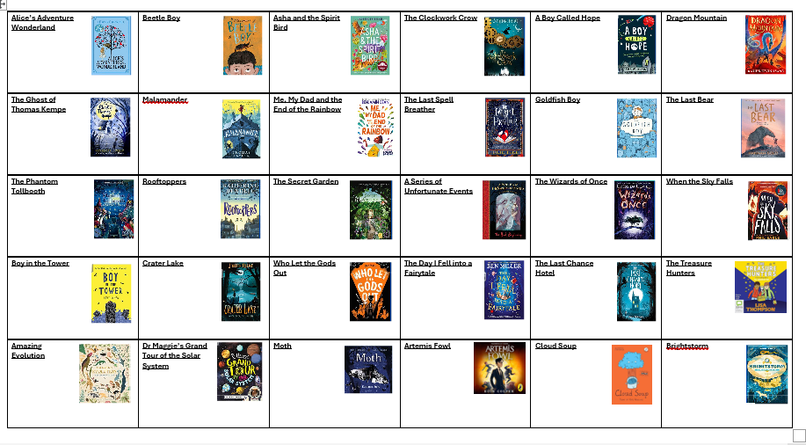
Year 5

Slide 25
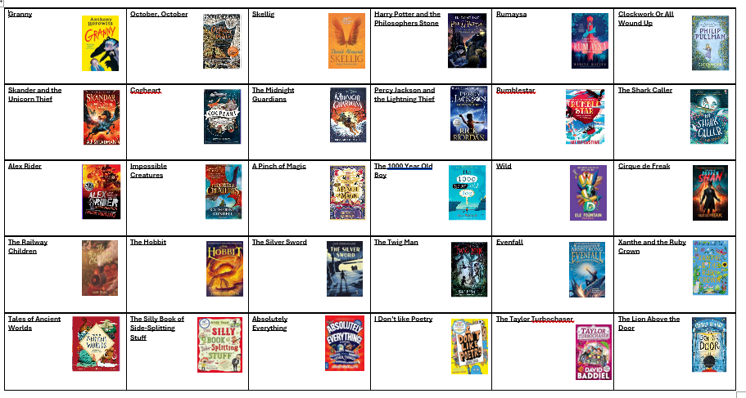
Year 6

Slide 28
at home
Readers are made by hearing an expert storyteller. Reading the same book again and again means they can hear and learn story telling patterns.
Getting you child to join with parts they know with a story telling voice.
Practising story telling voices
Letting go of any second-hand embarrassment-children don’t care about you in that way and will just enjoy the story.
As they become more proficient you can work on echo and choral reading.
Provide your children with books!
1.7 million children do not own one book.

Slide 29
Things to consider as your child moves into KeY Stage Two
Book Choice
Reading Aloud
Read to your child-Protected Story Time
Echo Reading and Choral Reading
Protected reading time

