Slide 1

Read, Write Inc. at Newton on Trent
Virtual Parent Workshop
September 2020

Slide 2


Slide 3
SO what is Read Write Inc.?
Since Jim Rose conducted a review of early reading in 2005, and reported that phonics is the most consistently successful approach to teach reading, phonics has been used as the main way to teach children to read in English schools.
Synthetic phonics is where children learn the letter sounds as building blocks to reading and writing words.
Read Write Inc. is a scheme to teach synthetic phonics. It was developed by Ruth Miskin, and has lots of research behind it.
Much of it’s success comes from the consistent approach the programme uses and the way in which it makes such strong links between what children are reading and what they are writing.
RWI sessions are positive, inclusive and foster lots of confidence in children.
It gives the children all the skills required for Reception and Year 1, and even exceeds the national curriculum requirements in some areas.
https://www.youtube.com/watch?v=i5O4yvZSOsc – Ruth Miskin’s explanation.

Slide 4
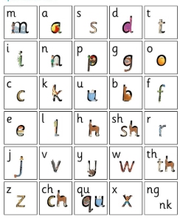
Sounds are taught in sets. There are 3 sets, 1,2 and 3. They get progressively more complex.
The sounds taught are ‘pure sounds’ that means saying mmm, not ‘muh’ or ‘em’
This video demonstrates the sounds children will be learning
https://www.youtube.com/watch?v=qB6SvZscxgg

Slide 5
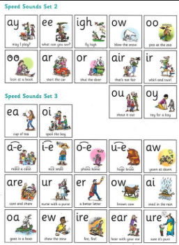
Set 2 and 3 sounds

Slide 6


Forming letters
Children are taught to write the sounds at the same time they are taught to read them. They learn a phrase to link the sound to an image on which to form the letter, such as Maisie, mountain, mountain or around the apple and down the leaf.

Slide 7
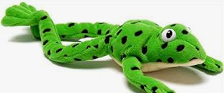
Fred talk and read
Meet Fred!
Fred can only talk in sounds, such as m-a-n and helps children learn to blend and segment words so they can read and write them. If you ask a child to ‘Fred talk and read’ that would mean saying the sounds in a word, blending them together and then saying what the word is: m-a-t, mat. Children may need to Fred talk the sounds repeatedly before they can hear the word. Encourage them to do it faster if they are struggling.

Slide 8



Red words and green words
RWI calls ‘tricky words’ red words. These are words that cannot be sounded out with Fred talk(these may change through your child’s English journey as sounds they have not been taught yet get taught later in the program, such as ‘e’ making the ‘ee’ sound. So he is a red word until children have learnt ‘e’). Said is always a red word. Other examples in children’s early learning are ‘the’ and ‘of’,
Green words are those that can be sounded out using phonics. Children will only be expected to read green words with sounds they have been taught. As children are learning to read words with a new sound, word cards have dots and dashes to show if they are a single letter grapheme or a digraph. RWI calls digraphs special friends, 2 letters making 1 sound.
As children become more confident, the dots and dashes are taken away.

Slide 9
Fred in your Head
As children become more familiar with recognising sounds and Fred talking them out loud, they are encouraged to internalise this process in ‘Fred in your Head’. This is where children say the sounds in their head and then only say the complete word aloud. The transition to this stage requires some encouragement and whispering or mouthing the sounds silently can really help your child take this step to becoming a more fluent reader.

Slide 10

Fred Fingers
Children are taught to segment words for spelling by putting a sound on each finger. At the early stages, we tell children how many fingers and therefore sounds they need, and later children count the sounds and fingers themselves.
They hold the fingers up on their non-dominant hand, with their palm facing them.
Children say the word, then pinch the sounds of their non-dominant hand with their writing hand, left to right, and then write down the word.

Slide 11
SO, What do we do with our phonics now then?
As children learn sounds and how to blend and segment them, they will read books closely matched to their developing skills. They will bring home corresponding Book Bag Books to match the book being read in school.
Children will have termly assessments to monitor their progress and group them appropriately.
There are 8 levels of book; Red Ditties, Green, Purple, Pink, Orange, Yellow, Blue and Grey. Children read the books several times to build accuracy, fluency and a story teller voice.
There are 8 levels of ‘Get Writing’ books linked to the story books, which children complete as they work through their reading books. These build their spelling, grammar and punctuation skills.

Slide 12
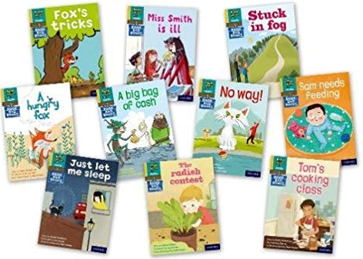
Reading at home
We are delighted to have purchased ‘Book Bag’ books for children to bring home to read with you. These are books which rely on phonics alone to decode the words.
RWI has cleverly designed a range of books to link to the book children are currently reading in school.
Children will also be reading other books at home concurrently. These will be Oxford Reading Tree books mostly to begin with. This will allow children to develop a range of reading strategies as they become confident readers. Please see the previous reading handout.

Slide 13
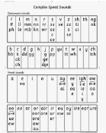
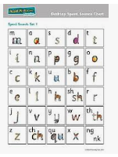
Embedded in school life
Obviously, reading and writing skills are used in many ways across the curriculum. Children will be encouraged to use all their new learning and strategies across the curriculum, such as going round the dinosaur’s bottom when writing about dogs in science to remembering which is the correct grapheme for the ‘ai’ sound in shape when writing their maths reasoning about shapes.
As such, the majority of teaching adults in school have had training and new resources have been purchased for each classroom, such as desk mats and speed sound charts.
In EYFS, children are encouraged to write in their play, such as signs for shops, letters, creating tickets for the train or anything else that crops up!

Slide 14
Logistics
As the sound sessions, story books and Get Writing activities cover all the requirements for many KS1 spelling rules, full stops, capital letters, question marks, exclamation marks and starting to use commas and speech, these sessions will be the children on the program’s English sessions.
RWI will be taught at the same time as the English national curriculum sessions in other classes so that any children who are further up the school, but still need to develop their skills in RWI, will be working on their next steps for English, and not missing out on other curriculum areas.
The program is designed to be delivered by TAs and teachers. It is currently taught by Mrs Robinson and Mrs Catchpole, Mrs Eden and sometimes Mrs RIley.

Slide 15
Keep up not catch up
The RWI program expects children to keep up, not catch up.
This means that children will be having ‘Pinny Time’ throughout the day where any sounds, or groups of words a child is struggling with are shown to them repeatedly. It can take as many as 30 exposures to a new sound or word for a child to have it embedded. For others, it may take more. These are short rapid events that happen quickly and do not require children to leave their play. The adult will got to the child.

Slide 16
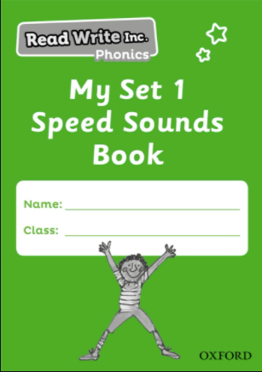
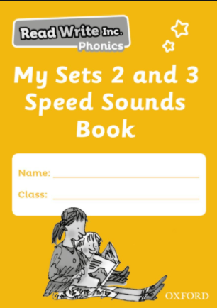
At home
Parents can support their child by reading both their RWI Book Bag book and their ORT books every day. Please record daily reads in your child’s Home School Book. This is really important evidence for us on what they struggle with/do well and how they are enjoying learning to read.
Each child will be provided with a Speed Sounds Book.
This will show you which sound they have learnt on
the day and give you the chance to consolidate the
learning with your child. The more a child practises,
the better they get. It is also very valuable to show
your child that you are interested in their education
and that it matters.

Slide 17
Questions?

